Slide 1
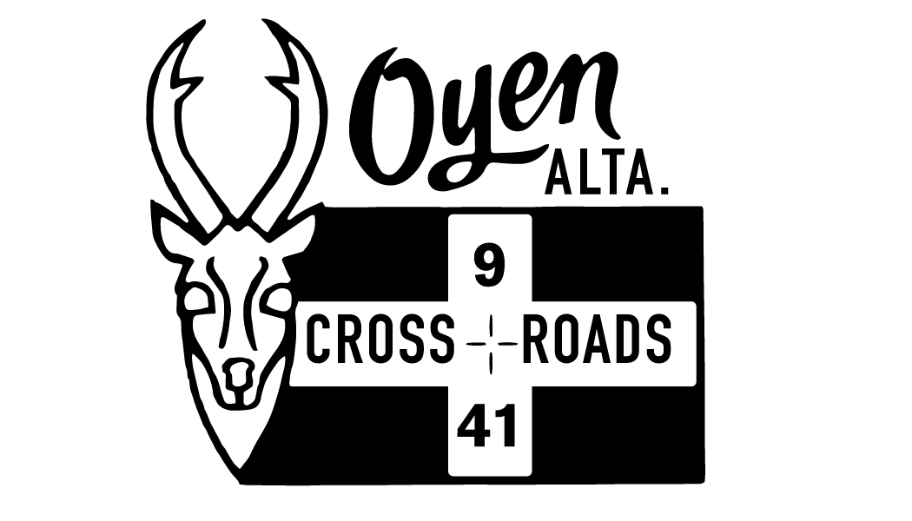
Tax & Assessment Information
TOWN HALL

Slide 2
Property tax is the largest and most important revenue source for municipalities.
Property taxes are calculated by multiplying the property's assessment by the tax rate of the specific property class.
Property’s Assessment x Tax Rate = taxes

Slide 3
Tax & Assessment Video Shared by Kneehill County via YouTube

Slide 4
Property Assessment “How is your assessment calculated?”
Physical Factors (size, year, model type, quality)
Provincial Variance, MGA & Regulations (MRAT, MRAC)
Market Value
Equity within similar property types
Assessment Software
Municipal Affairs Audit Function
Inspection Cycle
Notes:
Physical Factors – Hail Storm implications MRAC – Complaint process Market Value – Keystone & windmill construction increasing value (sales)

Slide 5
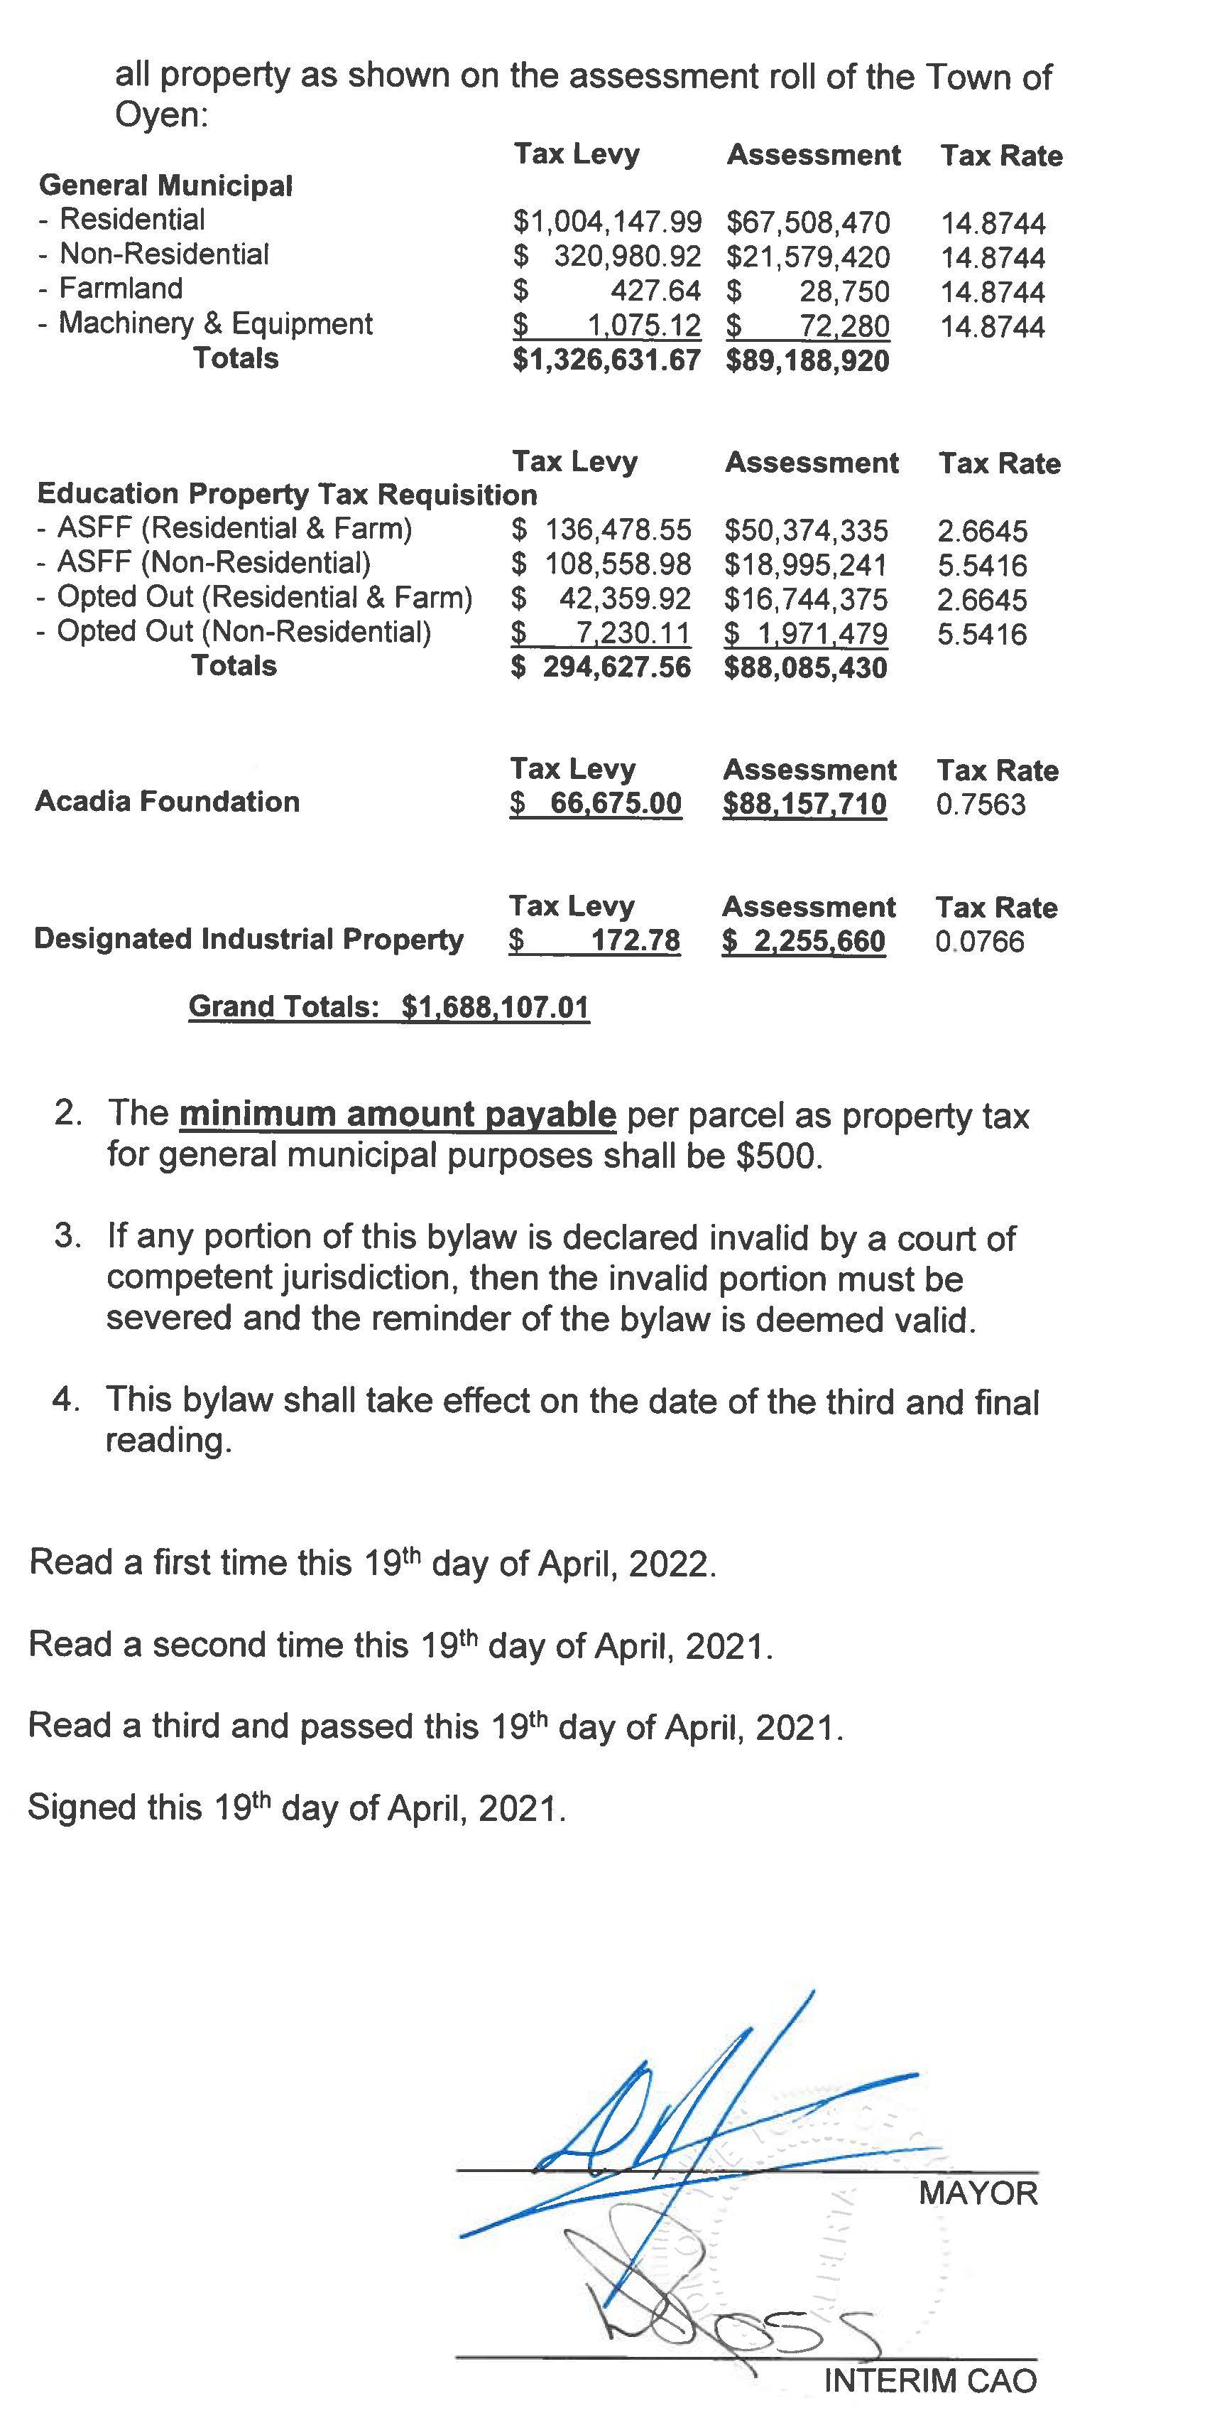
TAX RATE
“A municipality can set different tax rates for different classes and subclasses of property.”

Slide 6
Town of Oyen Tax Notice
100 - MUN: Oyen *includes mandated RCMP funding ($37,752 in 2023) 130 - SEN: Seniors Requisition 240 - ASFF: Education Requisition

Slide 7
Residential Single family dwelling Multifamily dwelling Vacant
SUBCLASSES
Non-Residential
Small Business (50 or less employees)
Non-Residential Vacant
RESOLUTIONS MADE AT AUGUST COUNCIL MEETING:
APPROVE THE ABOVE SUB-CLASSES
Increase non-residential rate by 3mil
decrease single family dwelling rate by 1mil

Slide 8
Motion made with regards to MINIMUM TAXES
Increase minimum tax on all taxable assessment classes
$500 → $1,000

Slide 9
Tax Rebate
Tax Rebate for Residential Subclass, single family dwelling, property owners that have municipal taxes higher than $4000.00 starting in the 2024 tax year, based on property square footage as follows:
“To incentivize new development in the Town of Oyen.”
“New developments will increase the overall assessment base, which will contribute to a lower tax rate for all.”
Under 10,000.00 sq ft rebate back to $4,000.00
10,001-15,000 sq ft rebate back to $4,500.00
15,001-18,000 sq ft rebate back to $5,500.00
18,001-20,000 sq ft rebate back to $6,500.00
Over 20,000 sq ft rebate back to $7,500.00

Slide 10
Financial Implications
Single Family Dwelling Tax Rate (-1mil) | Tax Rebate (20 properties) | Vacant Land | Minimum Tax increase to $1,000 | Non-residential Tax rate (+3mil)
-$68,967.65 | -$12,818.43 | +$24,437.81 | +$35,721.51 | +$26,603.16
$-81,786.08
$86,762.48
Reduction
Offsets

